Slide 1

National Retail Sales Forecast
Matt Burns
DSC 630
Bellevue University
2/29/2020

Slide 2
Project analysis slide 6
Abstract
This project will identify a methodology to predict National Retail Sales using publicly available data back to 2002. The forecast is a linear regression model in RStudio.
Background) The United States Census Bureau published monthly retail sales. It is used as a barometer of retail health and is used throughout the business press.
Problem Statement) Since National Retail Sales are widely reported by the media, its reported figure impacts the markets. Using other metrics like population growth, consumer debt burden, energy prices and Consumer Price Index, can we predict the National Retail Sales?
Scope) This analysis will mainly include features derived from structured data. 20 economic features will be included in the analysis and three different versions of National Retail Sales will be investigated. It is not advantageous to include unstructured data and it was not included.
We will be looking for leading indicators when we evaluate features.

Slide 3
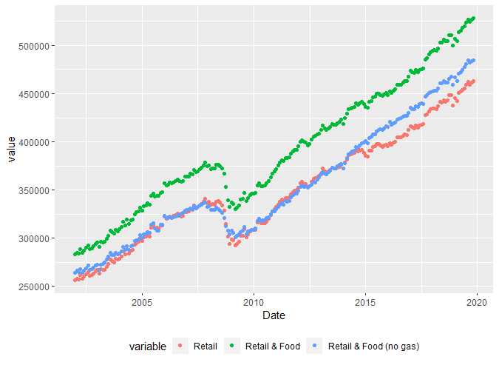
Project analysis slide 8
Retail Sales
3 OPTIONS
20 YEAR TIME SERIES
Retail Sales includes retails sales (including online sales), gasoline sales and auto sales. It does not include food & beverage sales.
Retail and Food includes retails sales (including online sales), gasoline sales and auto sales as well as food & beverage sales.
Retail and Food without gas includes retails sales (including online sales) and auto sales as well as food & beverage sales. ) Gasoline sales have been stripped out.
SOURCE
UNITS
U.S. Census Bureau
Data in Millions of Dollars

Slide 4
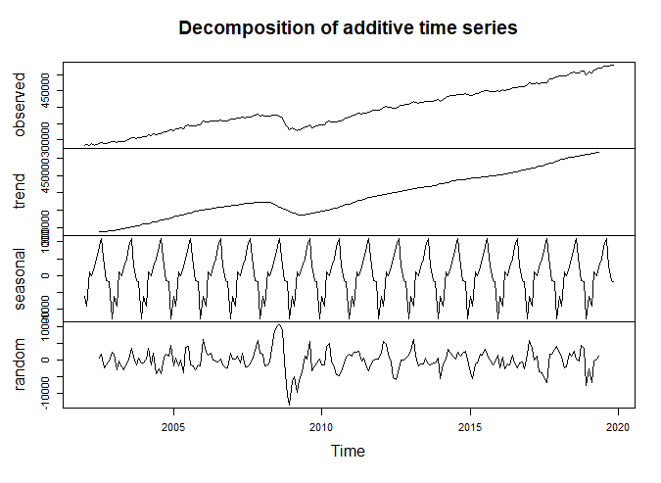
Project analysis slide 5
Decomposing Retail Sales

Slide 5
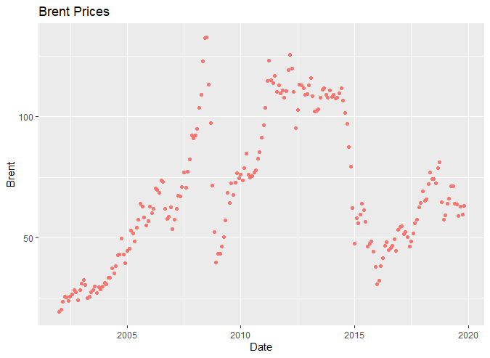
Project analysis slide 8
Candidate Predictors
20 Macro Candidates
Brent
Overview
Sample Candidate EDA Plot
The St. Louis Federal Reserve provided many of the candidate predictors.
The data was organized and without blanks
215 Observations were used
Only Debt Service Burden had a native frequency that wasn’t monthly
Illustrative Predictors
Gasoline Sales
Non Farm Payrolls
Consumer Price Index
Price of Brent Crude Oil
Mortgage Service Burden
120 OBESERVATIONS

Slide 6
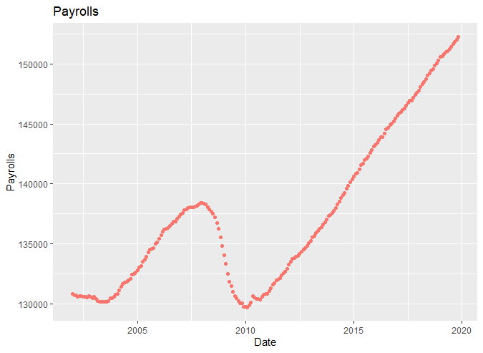
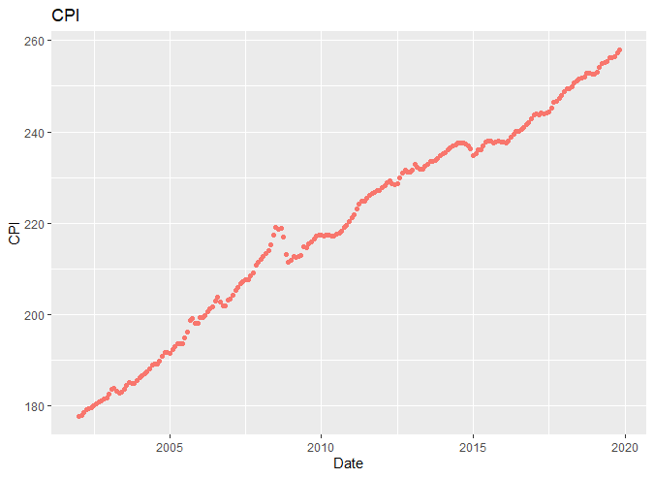
Project analysis slide 8
Candidate Predictors
Payrolls
CPI
120 OBESERVATIONS

Slide 7
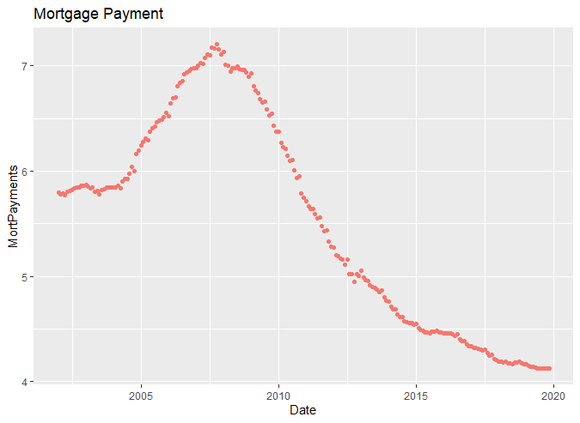
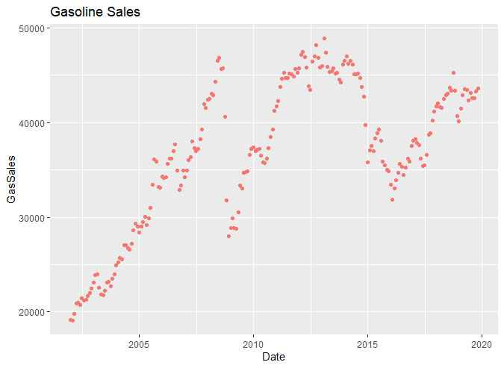
Project analysis slide 8
Candidate Predictors
Mortgage Payments
Gasoline Sales

Slide 8
Project analysis slide 8
3 Candidate Models
Payrolls, Brent, Mortgage Payments, Gas Sales and CPI
Payrolls, Brent, Mortgage Payments and CPI
Payrolls, Brent, Mortgage Payments and CPI (Food and Bev.)
Call:
lm(formula = Retail_and_Food ~ Payrolls + Brent + MortPayments + GasSales + CPI, data = df)
Residuals:
Min 1Q Median 3Q Max
-24467.3 -2195.8 544.2 3065.1 14151.0
Coefficients:
Estimate Std. Error t value Pr(>|t|)
(Intercept) -4.377e+05 1.641e+04 -26.679 < 2e-16 ***
Payrolls 4.393e+00 1.363e-01 32.220 < 2e-16 ***
Brent -2.597e+02 6.250e+01 -4.155 4.78e-05 ***
MortPayments -1.070e+04 6.265e+02 -17.077 < 2e-16 ***
GasSales 2.286e+00 2.959e-01 7.725 4.79e-13 ***
CPI 9.988e+02 5.746e+01 17.384 < 2e-16 ***
---
Signif. codes: 0 ‘***’ 0.001 ‘**’ 0.01 ‘*’ 0.05 ‘.’ 0.1 ‘ ’ 1
Residual standard error: 5134 on 206 degrees of freedom
(3 observations deleted due to missingness)
Multiple R-squared: 0.9939, Adjusted R-squared: 0.9937
F-statistic: 6670 on 5 and 206 DF, p-value: < 2.2e-16
Call:
lm(formula = Retail_and_Food ~ Payrolls + Brent + MortPayments + CPI, data = df)
Residuals:
Min 1Q Median 3Q Max
-18872.6 -2188.5 983.2 3847.8 12595.8
Coefficients:
Estimate Std. Error t value Pr(>|t|)
(Intercept) -5.222e+05 1.386e+04 -37.662 < 2e-16 ***
Payrolls 4.937e+00 1.322e-01 37.341 < 2e-16 ***
Brent 1.984e+02 2.238e+01 8.866 3.55e-16 ***
MortPayments -9.647e+03 6.928e+02 -13.925 < 2e-16 ***
CPI 1.256e+03 5.309e+01 23.651 < 2e-16 ***
---
Signif. codes: 0 ‘***’ 0.001 ‘**’ 0.01 ‘*’ 0.05 ‘.’ 0.1 ‘ ’ 1
Residual standard error: 5817 on 207 degrees of freedom
(3 observations deleted due to missingness)
Multiple R-squared: 0.9921, Adjusted R-squared: 0.9919
F-statistic: 6485 on 4 and 207 DF, p-value: < 2.2e-16
lm(formula = Retail_and_Food ~ Payrolls + Brent + MortPayments + CPIfoodbev, data = df)
Residuals:
Min 1Q Median 3Q Max
-21965.1 -2355.4 695.8 4366.9 11268.1
Coefficients:
Estimate Std. Error t value Pr(>|t|)
(Intercept) -5.542e+05 1.554e+04 -35.66 <2e-16 ***
Payrolls 5.720e+00 1.250e-01 45.77 <2e-16 ***
Brent 3.039e+02 2.198e+01 13.83 <2e-16 ***
MortPayments -9.742e+03 7.921e+02 -12.30 <2e-16 ***
CPIfoodbev 8.755e+02 4.378e+01 20.00 <2e-16 ***
---
Signif. codes: 0 ‘***’ 0.001 ‘**’ 0.01 ‘*’ 0.05 ‘.’ 0.1 ‘ ’ 1
Residual standard error: 6536 on 207 degrees of freedom
(3 observations deleted due to missingness)
Multiple R-squared: 0.99, Adjusted R-squared: 0.9898
F-statistic: 5125 on 4 and 207 DF, p-value: < 2.2e-16
The first option will be selected due to its lower standard error and its R² of 99.37%.

Slide 9
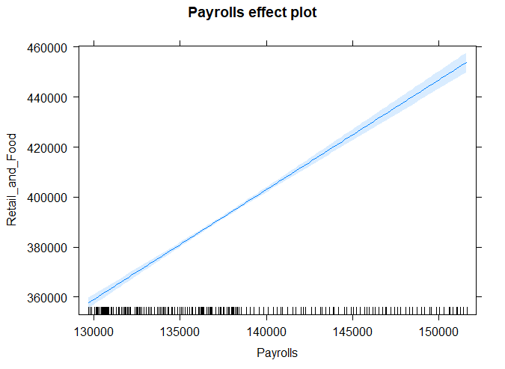
Project analysis slide 5
Payrolls Influence
Payrolls has a large influence on the Retail Sales. The values for Payrolls result in $360Bn on the low end and just under $460MM on the high end. Also the T-Value is 32.2 which tells us that Payrolls’ impact is large in comparison to its standard error.
Additionally the slope of the relationship makes sense. As more people have jobs, more retail good will be purchased.

Slide 10
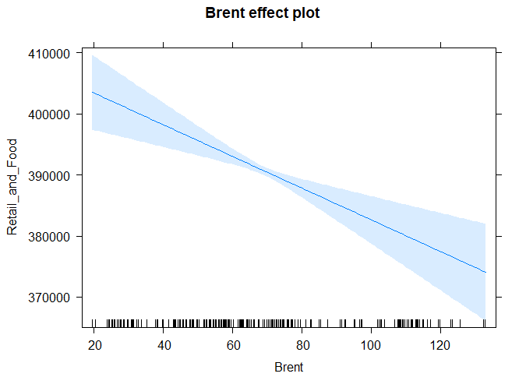
Project analysis slide 5
Brent Price’s Influence
Brent’s Price influences on the Retail Sales inversely. The Retail Sales values resulting from Brent range from $405Bn on Brent’s low end and just under $380MM on Brent’s high end. Also the T-Value is -4.2 which tells us that Brent’s impact is large enough in comparison to its standard error to keep in the model.
Additionally the slope of the relationship makes sense. As oil prices rise , the economy tends to slow which pulls down retail sales.

Slide 11
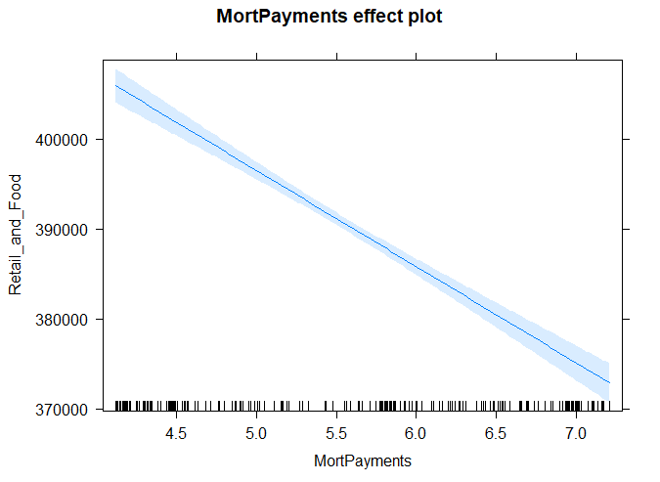
Project analysis slide 5
Homeowner Mortgage Payments’ Influence
Mortgage Payments slightly influences Retail Sales inversely. The Retail Sales values resulting from Mortgage Payments range from $405Bn on Mortgage Payments’ low end and just under $375MM on Mortgage Payments’ high end. Also the T-Value is -17.1 which tells us that Mortgage Payments’ impact is large enough in comparison to its standard error to keep in the model.
Additionally the slope of the relationship makes sense. As consumers spend more on their mortgages, retail sales are crowed out.

Slide 12
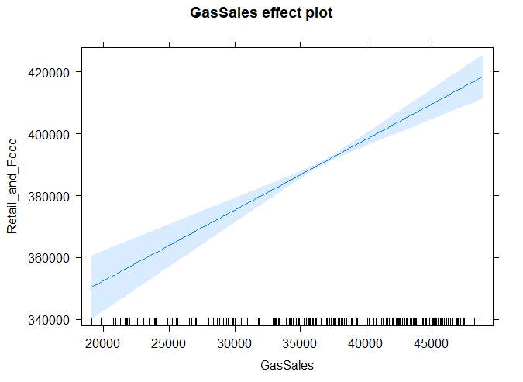
Project analysis slide 5
Gasoline Sales’ Influence
Gasoline Sales will require more investigation before this project is submitted.
The statistics work, but I need to think through the real world implications. ☹

Slide 13
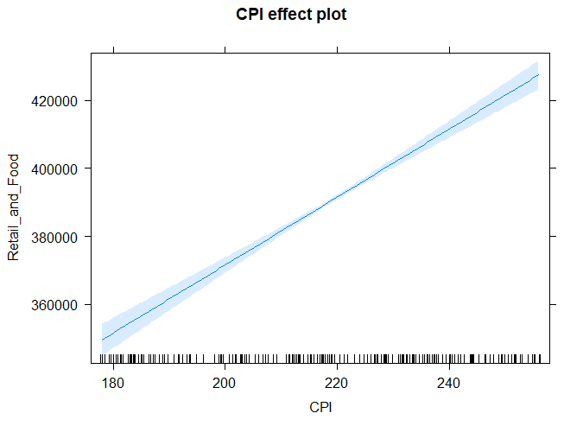
Project analysis slide 5
CPI’s Influence
CPI influences Retail Sales positively. The Retail Sales values resulting from Mortgage Payments range from $370Bn on CPI’s low end and just over $420MM on CPI’s high end. Also the T-Value is 17.4 which tells us that CPI’s impact is large enough in comparison to its standard error to keep in the model.
Additionally the slope of the relationship makes sense. As goods cost more, retail sales increase.

Slide 14
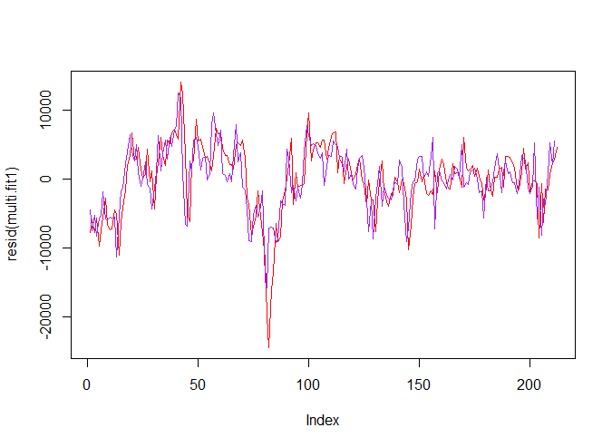
Project analysis slide 5
Lagging Variables
I used slide to lag the Price of Brent.
It helped get a slightly better R² and also reduced some of my residuals. The plot to the right show residuals without lagging in red and residuals with lagging in blue. By lagging Brent I was able to reduce the residuals.

Slide 15
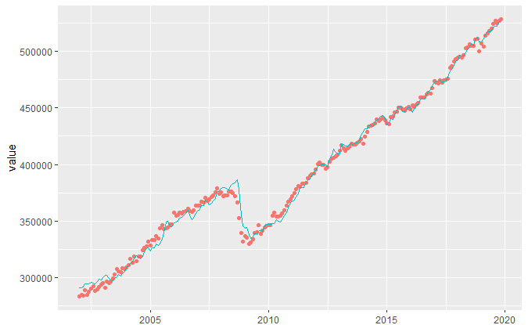
Project analysis slide 5
Fitted Values

Slide 16
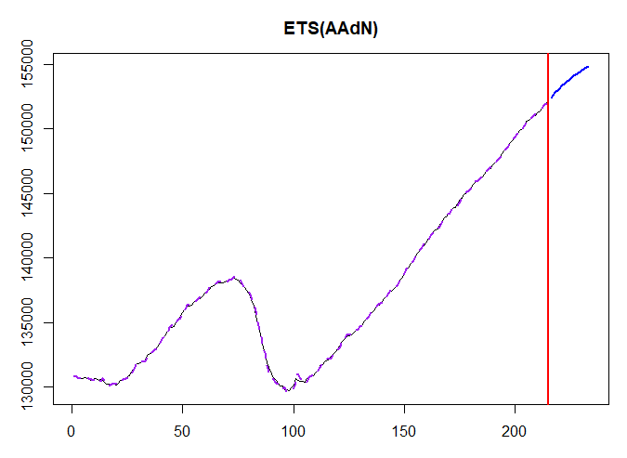
Project analysis slide 5
Exponential Smoothing Payrolls
Point forecast Lower bound (2.5%) Upper bound (97.5%)
216 152434.3 152204.3 152664.3
217 152628.0 152221.8 153034.1
218 152813.8 152209.1 153418.5
219 152992.3 152170.2 153814.3
220 153163.5 152108.5 154218.5
221 153327.8 152026.8 154628.9
222 153485.6 151927.3 155043.8
223 153637.0 151812.0 155461.9
224 153782.3 151682.5 155882.0
225 153921.7 151540.2 156303.2

Slide 17
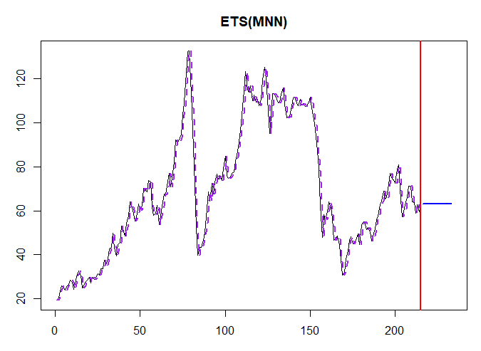
Project analysis slide 5
Exponential Smoothing Brent Price
Time Series:
Start = 216
End = 225
Frequency = 1
Point forecast Lower bound (2.5%) Upper bound (97.5%)
216 63.21 53.11813 75.21922
217 63.21 49.42558 80.83879
218 63.21 46.76720 85.43389
219 63.21 44.63748 89.51007
220 63.21 42.84167 93.26210
221 63.21 41.28040 96.78938
222 63.21 39.89493 100.15068
223 63.21 38.64718 103.38411
224 63.21 37.51083 106.51602
225 63.21 36.46680 109.56551

Slide 18
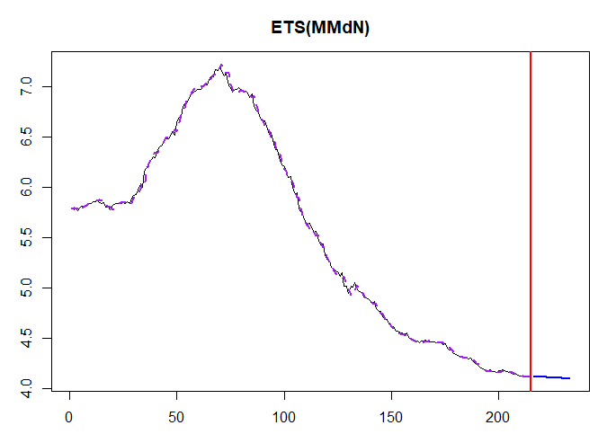
Project analysis slide 5
Exponential Smoothing Homeowner Mortgage Payments
Time Series:
Start = 216
End = 225
Frequency = 1
Point forecast Lower bound (2.5%) Upper bound (97.5%)
216 4.121307 4.076212 4.166902
217 4.119732 4.061027 4.179286
218 4.118195 4.044697 4.193028
219 4.116695 4.027435 4.207933
220 4.115231 4.009395 4.223860
221 4.113802 3.990695 4.240706
222 4.112408 3.971432 4.258388
223 4.111047 3.951685 4.276836
224 4.109719 3.931522 4.295994
225 4.108424 3.911002 4.315811

Slide 19
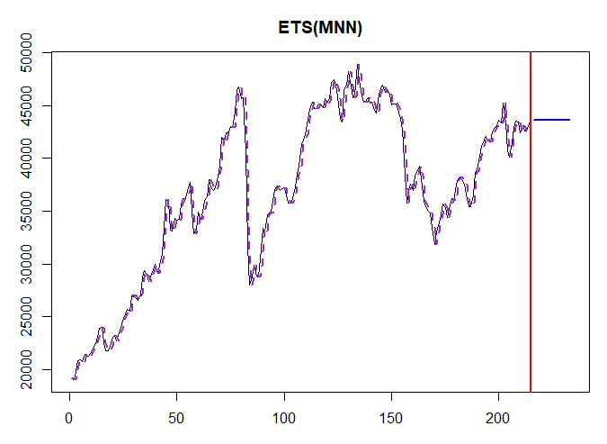
Project analysis slide 5
Exponential Smoothing Gasoline Sales
Time Series:
Start = 216
End = 225
Frequency = 1
Point forecast Lower bound (2.5%) Upper bound (97.5%)
216 43598 40639.59 46771.77
217 43598 39473.78 48153.12
218 43598 38601.95 49240.67
219 43598 37881.93 50176.57
220 43598 37258.73 51015.85
221 43598 36704.13 51786.69
222 43598 36201.42 52505.83
223 43598 35739.70 53184.15
224 43598 35311.40 53829.23
225 43598 34911.03 54446.56

Slide 20
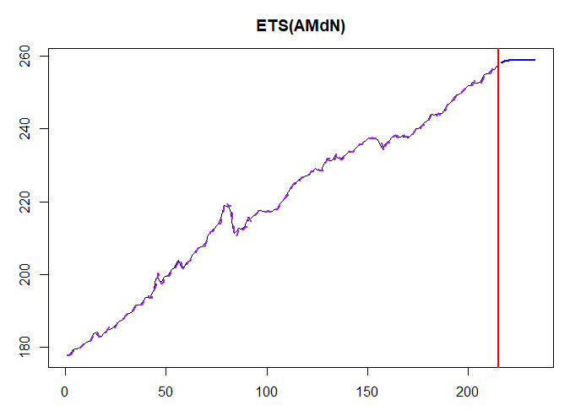
Project analysis slide 5
Exponential Smoothing CPI
Time Series:
Start = 216
End = 225
Frequency = 1
Point forecast Lower bound (2.5%) Upper bound (97.5%)
216 258.3282 257.1726 259.4814
217 258.5594 256.3750 260.7314
218 258.6956 255.5758 261.8238
219 258.7758 254.7984 262.7812
220 258.8230 254.0597 263.6247
221 258.8508 253.3769 264.3601
222 258.8672 252.7556 265.0464
223 258.8768 252.1554 265.6740
224 258.8825 251.6095 266.2494
225 258.8858 251.1223 266.7778

Slide 21
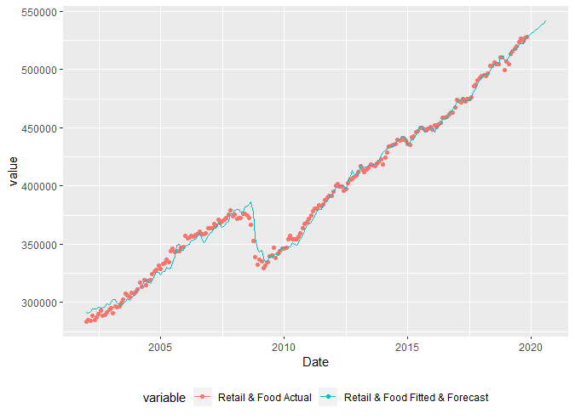
Project analysis slide 5
Plot Forecast

Slide 22
Project analysis slide 5
Variance
Month | Forecast | Actual | Variance ($) | Variance (%)
Dec. 2019 | 529,404 | 528,367 | -1,037 | -0.19%
Jan. 2020 | 530,924 | 529,766 | -1,158 | -0.22%
Feb. 2020 | 532,443
Mar. 2020 | 533,962
Apr. 2020 | 535,481
May 2020 | 537,000
Jun. 2020 | 538,519
Jul. 2020 | 540,039
Aug. 2020 | 541,558

Slide 23
Project analysis slide 5
Potential Improvements
Think though gasoline sales and maybe replace with gas prices.
Smarten up predictor forecasts.
Build scenarios based on flexing input variables.
Clean up forecast generation.

